Slide 1

Language Learning on the Go: A Mobile App for Interactive Language Acquisition
TEAM:
S. Jayashree Jeeva .V Bhanu Prakash Reddy

Slide 2
Problem Statement
The current problem with existing language learning mobile apps is that they lack interactive features that can enhance engagement and retention rates of the users that make the user to be inactive.
This app aims to solve all that with personalized paths, interactive activities, and engaging content, catering to diverse learners on the go!

Slide 3
Proposed design work
Key Components
User Profile Management
Interactive Lessons
Gamified Learning
Speech Recognition
Progress Tracking
Making them active with notifications
Providing certificates
Functionality
Personalized Learning Paths
Offline Mode
Social Integration
Real-time Feedback

Slide 4
Architecture Design
Client-Side: Mobile app interfaces with the server to fetch and update user data, lesson content, and analytics.
Server-Side: Manages user accounts, lesson databases, and analytics. Implements algorithms for personalized recommendations.

Slide 5
UI Design
Layout Design
A clean and intuitive layout will be implemented, featuring clear navigation menus and visually appealing graphics. The interface will adapt to both portrait and landscape orientations.
Feasible Elements Used
Buttons for navigating between screens and starting activities.
Text fields for entering responses during exercises.
Sliders for adjusting settings and difficulty levels.
Charts and graphs for displaying progress metrics.
Chat windows for interacting with peers and tutors.
Audio playback controls for listening practice.
Image galleries for visualizing concepts.

Slide 6
Element Functions
Navigation menu: Provides quick access to all sections within the app.
Home screen: Displays recent activity, upcoming events, and recommended lessons.
Lesson selection: Allows users to choose from available courses and units.
Exercise screen: Presents interactive tasks tailored to specific language skills.
Chat window: Enables real-time communication with fellow learners and native speakers.
Profile page: Shows user statistics, achievements, and account management options.
Settings: Adjusts app preferences, including notification settings, language choice, and offline mode activation.

Slide 7
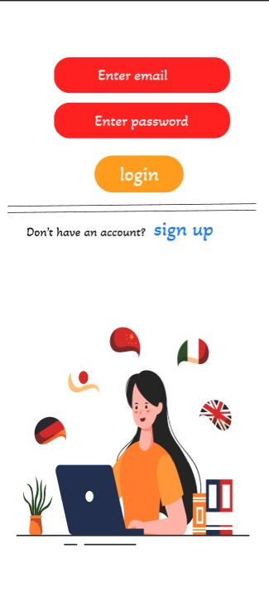
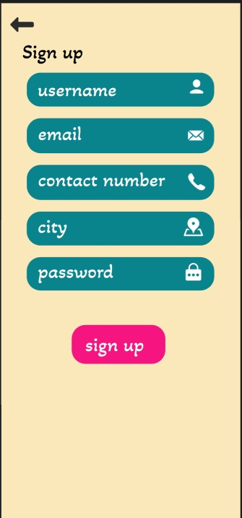
LOGIN PAGE
SIGN UP PAGE
Login Template
To ensure secure authentication, a simple yet effective login template will be developed. Users may log in using email, phone number, or social media accounts. Passwords should follow strong security guidelines, and two-factor authentication will be optional but highly encouraged.

Slide 8

CONCLUSION
Our proposed mobile app aims to revolutionize the way people learn languages on-the-go. With its focus on interactivity, personalization, multimedia resources, social features, progress tracking, offline support, and adaptive content generation, it promises to deliver an unparalleled language acquisition experience.

Slide 9
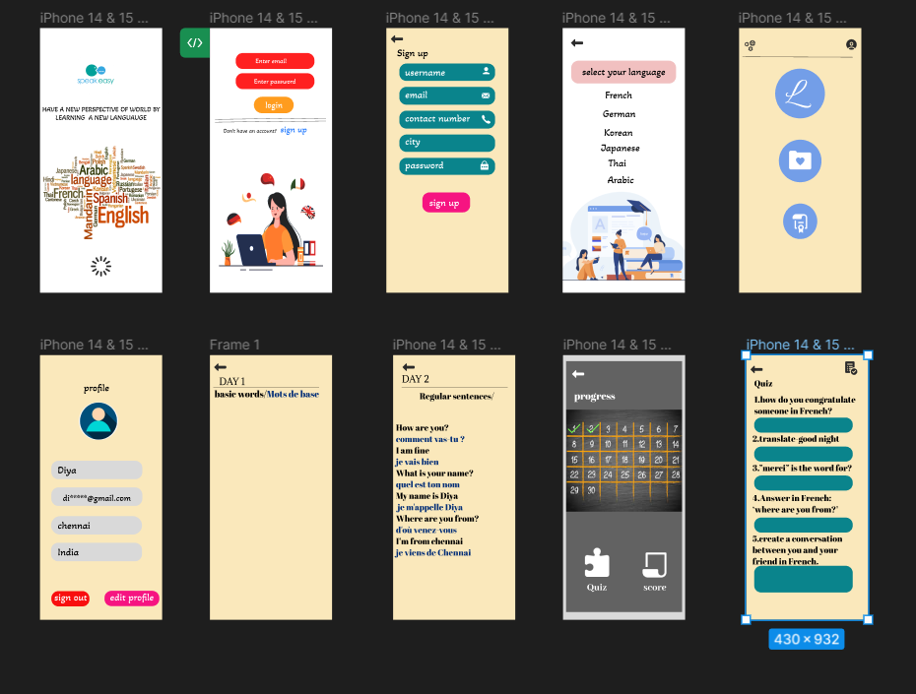
Application link
https://www.figma.com/file/yQ10H5o5r2e21XJ7AwiJdy/language?type=design&node-id=0%3A1&mode=design&t=Esl8hQvyytrAKUSZ-1

Slide 10
THANK YOU….

